Slide 1




Slide 2


SYNONYMS AND ANTONYMS

Slide 3
WHAT IS A SYNONYM?
A synonym is a word having the same or nearly the same meaning as another word in certain contexts.
Notes:
In simple terms, a root word is a complete word that you can't break down any further.
Adding prefixes (strings of letters added to the front of a word) and suffixes (strings of letters added to the end of a word) can change the meaning of a root word in English. Words such as act, form and legal are among the most common root words in English that we use in everyday conversations. Unlike suffixes and prefixes, root words in the English language can stand alone.
We use root words every day, even if we don't realise it! Root words are simply words that are used (written or spoken) that do not have an additional prefix or suffix added to the end or beginning of them. In traditional root words, these words come from Latin and Greek words, and typically do not stand alone as a complete word. Understanding the meanings of common root words can help you work out the meanings of new words as you encounter them.

Slide 4
WHAT IS AN ANTONYM?
An antonym is a word having a meaning opposite to that of another word, such as hot and cold, short and tall. An antonym is the antonym of synonym.
Notes:
Interaction with others is a routine job of businesses in today’s world.

Slide 5
Concept
Normally english language vocabulary have different meanings at different sentences.
But all the vocabulary can be understood by using root words.
English language have many root words.
When we know the meaning of the root words we can know the meaning of the vocabulary.
Root word is a word that can form the basis of a new word.
Notes:
Base words are similar to root words, but they are not exactly the same. A base word is a standalone English word that can also form other words by using prefixes and suffixes (whereas, root words cannot always be used as an independent word). When a prefix or suffix is added to a base word, the word's meaning changes and a new word is formed.

Slide 6
Root words
Some of the root words are:
Ambi, amphi – on both sides , around.
Example – ambidextrous – able to use both hands equally.
ambiguous – having more than one meaning.
Ami – love.
Example – amiable – friendly and pleasant.
amity – friendly and peaceful relations.
Ante – before or in front
Example – antecede – to come before something in time.
antemeridian – before noon.
Notes:
The answer you link to says the minute hand gains
55
55 minutes on the hour hand, not the other way around. As you say, in one hour the minute hand moves
360∘, which the answer calls
60 minutes. In one hour, the hour hand moves
30∘, so the minute hand gains
330∘=55 minutes.

Slide 7
Root words
Anti – against or opposite of
Example – antibody – a substance that destroys the micro organism.
antiseptic – preventing infection.
Astro , aster – stars, outer space
Example – astronaut – a person travelling through stars.
astronomer – someone who studies the stars.
Avi – bird
Example – aviary – a large enclosure for birds.

Slide 8
Root words
Auto – self , same, one.
Example – automatic – moving by itself.
autograph – a person's own signature.
Capt, ceive – take or hold
Example – intercept – to stop or interrupt.
perceive – to take notice of something.
Cogn – know
Example – cognition – the process of acquiring knowledge.
incognito – disguised so no one knows.

Slide 9
Root words
Cred – believe.
Example – credence – believe that something is true.
credulous - believing things too easily.
Dys – abnormal or bad.
Example – dyspecia – abnormal digestion.
dystopia – an imaginary place of total misery.
Ep – on ,over, among ,upon
Example – epidemic – the rapid spread of something negative.
epicentre – centre of the earthquake.

Slide 10
Root words
Haem – blood
Example – haemoglobin – red blood particle.
haemorrhage – clotting of the blood.
Idio – peculiar, personal
Example – idiomatic – peculiar to a particular language.
idiot – someone who is distinctly foolish or stupid.
Viv – live or life
Example – revival – act of bringing back to life.
vital – pertaining to live.
Notes:
The elevator test is a business concept that venture capitalists and investors have used for many years to judge a pitch for a new product or business idea. In the world of business technology, the elevator test looks a little different, depending on if you’re using it to sell a solution, to better organize an internal project team, or just to get to know a colleague.

Slide 11
Root words
Acri – bitter
Example – acrid – unpleasantly bitter
acrimony – ill feeling
Archy – rule
Example – hierarchy – a ranking system or procedure to authority
monarchy – form of government with a monarch at the head
Pan – all
Example – pandemic – prevalent over a whole country
panacea – a solution for all difficulties or diseases
Notes:
If you're job searching, you can use your elevator pitch at job fairs and career expos, and online in your LinkedIn summary or Twitter bio, for example. An elevator speech is a great way to gain confidence in introducing yourself to hiring managers and company representatives. You can also use your elevator pitch to introduce yourself at networking events and mixers. If you're attending professional association programs and activities, or any other type of gathering, have your pitch ready to share with those you meet.
Your elevator pitch can be used during job interviews, especially when you're asked about yourself. Interviewers often begin with the question, "Tell me about yourself"—think of your elevator pitch as a super-condensed version of your response to that request.

Slide 12
Root words
Thei – god
Example – atheist – a person who disbelieves in the existence of god
pantheist – worship of all gods of different religion
Cert – sure
Example – certify – confirm in a formal statement
certainly – used to emphasize the speakers belief is true
Somni or hypno – sleep
Example – insomnia – inability to sleep
somniloquy – talking aloud in sleep
hypnosis – hypnotic state
hypnotism – study or practise of hypnotisis

Slide 13
Root words
Soli – single
Example – solitude – a state of being alone
Omni – all
Example – omnivore – animal that eat both plants and animals
omnipresent – present everywhere
Vore – to eat greedily
Example – herbivore – animals that feed on plants
omnivore – animals feeds on both plants and animals
Notes:
Restrict the speech to 30-60 seconds. You don't need to include your entire work history and career objectives. Your pitch should be a short recap of who you are and what you do.

Slide 14
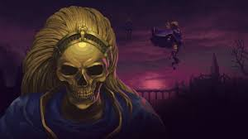
Question : 1
Select the word or phrase which best expresses the meaning of the given word:
BLASPHEMOUS
Convict
Gather
Impious
Pious
Notes:
Even though it's a short pitch, your elevator speech should be compelling enough to spark the listener's interest in your idea, organization, or background.

Slide 15
Explanation
The meaning of the word is it is irreverent and sacrilegious against god.
This relates exactly to impious
Notes:
Your elevator pitch should explain who you are and what qualifications and skills you have. Try to focus on assets that add value in many situations. This is your chance to brag a bit—avoid sounding boastful, but do share what you bring to the table.

Slide 16
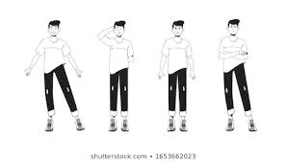
Question: 2
Select the word or phrase which best expresses the meaning of the given word:
BAFFLE
Regard
Confound
Perplex
Scorn
Notes:
The best way to feel comfortable about giving an elevator speech is to practice it until the speed and “pitch” come naturally, without sounding robotic. You will get used to varying the conversation as you practice doing so. The more you practice, the easier it will be to deliver it when you’re at a career networking event or job interview

Slide 17
Explanation
BAFFLE means to bewilder by the event happened.
Perplex means exactly the same.
Scorn means to hate something and to avoid it and hate it completely.
Confound means to defeat or to prove or to cause confusion and surprise.
Regard means to consider.
Notes:
You often aren’t interviewing for a specific position when you deliver your pitch, so you want to appear open-minded and flexible. Don’t lead with the stuff you’d rather not be doing. (For example, if you don’t want to travel a lot for work, that’s completely legitimate —but you needn’t volunteer that information right off the bat.) This is your chance to make a great first impression with a potential employer. Don’t waste it.

Slide 18

Question: 3
Select the word or phrase which best expresses the meaning of the given word:
DEFER
Indifferent
Defy
Differ
Postpone
Notes:
You don't need to get too specific. An overly targeted goal isn't helpful since your pitch will be used in many circumstances, and with many different types of people. But do remember to say what you're looking for. For instance, you might say, "a role in accounting" or "an opportunity to apply my sales skills to a new market" or "to relocate to San Francisco with a job in this same industry."

Slide 19
Explanation
Indifferent : having no particular interest or sympathy, unconcerned.
Defy : openly resist or refuse to obey.
Differ : be unlike or dissimilar.
Postpone : cause or arrange for (something) to take place at a time later than that first scheduled.
Defer : put off (an action or event) to a later time; postpone
Notes:
In some cases, using jargon can be a powerful move—it demonstrates your industry knowledge. But be wary of using jargon during an elevator pitch, particularly if you're speaking to recruiters, who may find the terms unfamiliar and off-putting. Keep it simple and focused.

Slide 20
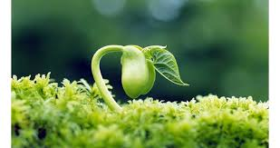
Question: 4
Select the word or phrase which best expresses the meaning of the given word:
GERMINATE
Decay
Breed
Produce
Sprout

Slide 21
Explanation
Decay : rot or decompose through the action of bacteria and fungi.
Produce : make or manufacture from components or raw materials.
Sprout : put out shoots.
Breed : mate and then produce offspring.
Germinate : begin to grow and put out shoots after a period of dormancy.

Slide 22
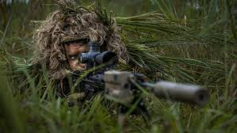
Question: 5
Select the word or phrase which best expresses the meaning of the given word:
CAMOUFLAGE
Aggressive
Deception
Vigilant
Honour

Slide 23
Explanation
Camouflage refers to to hide or to deceive by the presence where the soldiers do it in the borders
Vigilant refers to keeping careful watch over something

Slide 24

Question : 6
Select the word which is OPPOSITE in the meaning of the given word:
ABSTAIN
A. Hoard
B. Tolerate
C. Forbear
D. Begin

Slide 25
Explanation
Hoard : a stock or store of money or valued objects, typically one that is secret or carefully guarded. Tolerate : bear, forbear, forebear, abide.
Forbear : bear, forbear, forebear, abide.
Begin : commence, induct.
Abstain : restrain oneself from doing or enjoying something. Antonym of Abstain is Begin.

Slide 26
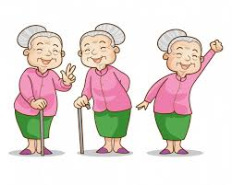
Question : 7
Select the word which is OPPOSITE in the meaning of the given word:
BENIGN
Malevolent
Soft
Friendly
Unwise

Slide 27
Explanation
Soft : easy to mould, cut, compress, or fold, not hard or firm to the touch, soft, bland, malleable, moderate, tender, flaccid
Friendly : kind and pleasant.
Unwise : (of a person or action) not wise or sensible, foolish.
Malevolent : having or showing a wish to do evil to others.
Benign : gentle and kind. Appropriate antonym of Benign is Malevolent.

Slide 28
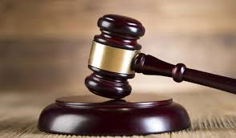
Question : 8
Select the word which is OPPOSITE in the meaning of the given word:
ACQUIT
A. Deprive
B. Retreat
C. Convict
D. Conceal

Slide 29
Explanation
Retreat : digress, recoil, shrink back, retrograde, fall back.
Conceal : hide, secrete, conceal, stash, wrap.
Deprive : debar, shear, bereave, mulct, denude.
Convict : declare (someone) to be guilty of a criminal offense by the verdict of a jury or the decision of a judge in a court of law.
Acquit : liberate, rid, set free, release, exempt. Antonyms of Acquit is Convict.

Slide 30
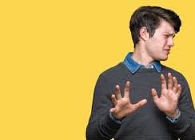
Question : 9
Select the word which is OPPOSITE in the meaning of the given word:
AVERSION
A. Avoidable
B. Awareness
C. Hatred
D. Liking

Slide 31
Explanation
Avoidable: Able to be avoided or prevented.
Awareness: Knowledge or perception of a situation or fact.
Hatred: Intense dislike; hate.
Liking: A feeling of regard or fondness.
AVERSION: A strong dislike or disinclination. Antonym of AVERSION is Liking

Slide 32
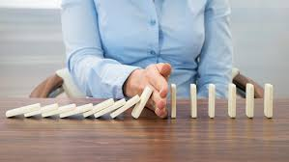
Question : 10
Select the word which is OPPOSITE in the meaning of the given word:
MITIGATE
A. Abate
B. Aggravate
C. Allay
D. Alleviate

Slide 33




THANK YOU
+91 78150 95095
codemithra@ethnus.com
www.codemithra.com

